Slide 1
Docker – Kubernetes Introduction

Slide 2
What is Kubernetes?
Kubernetes is a tool that helps us to run and manage applications in containers.
Developed by Google Lab in 2014.
Also known as k8s.
Definition
It is an open-source container orchestration platform that automates the deployment, management, and scaling of container-based applications in different kinds of environments like physical, virtual, and cloud-native computing foundations.

Slide 3
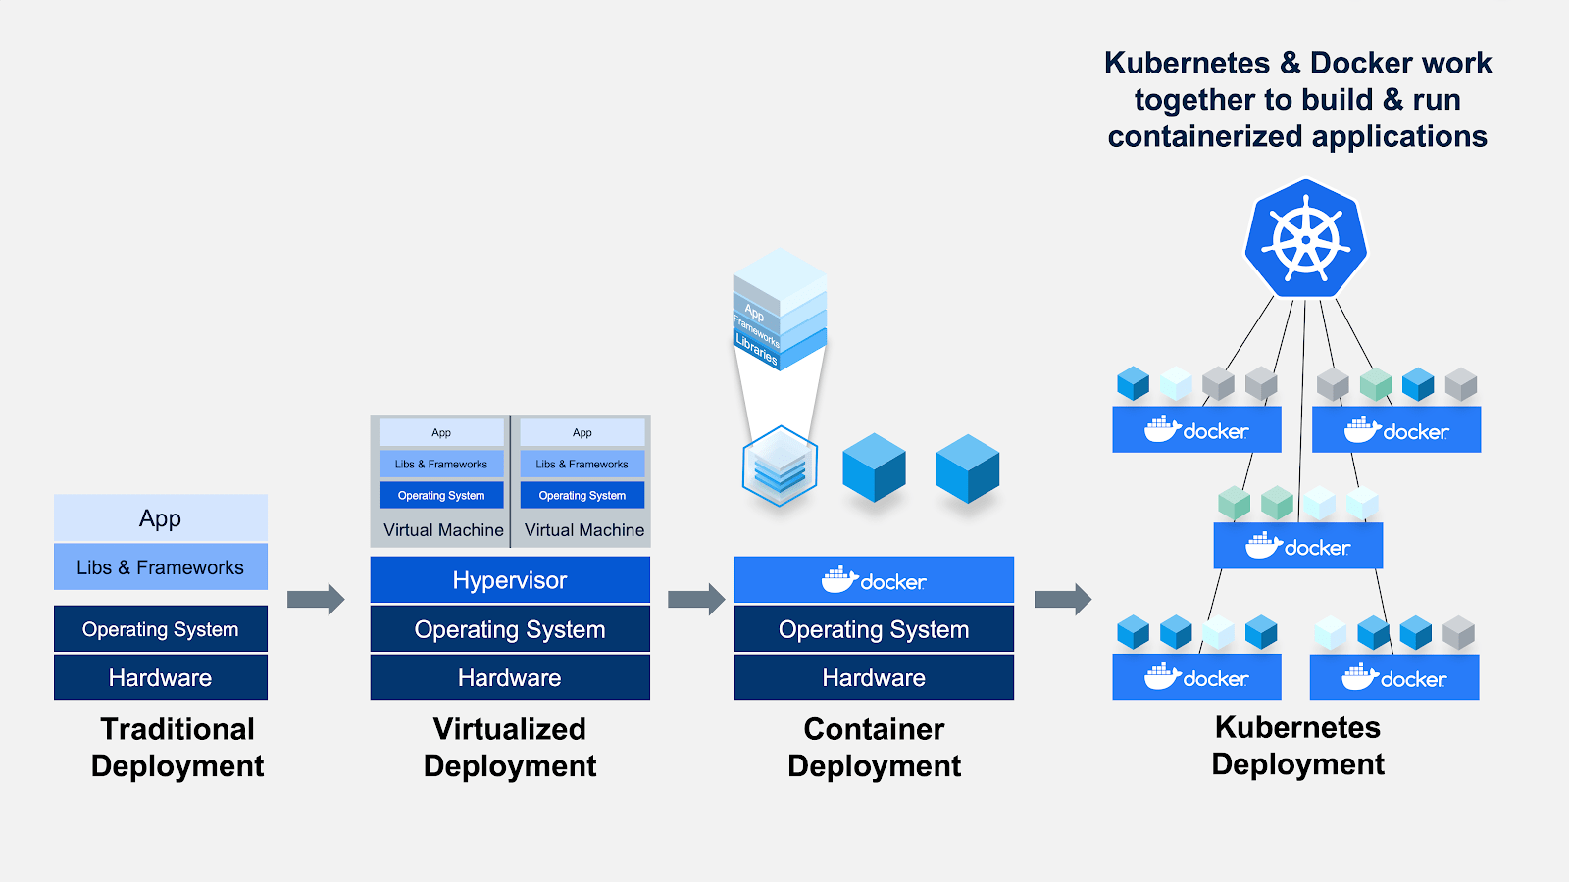
Different Deployments

Slide 4
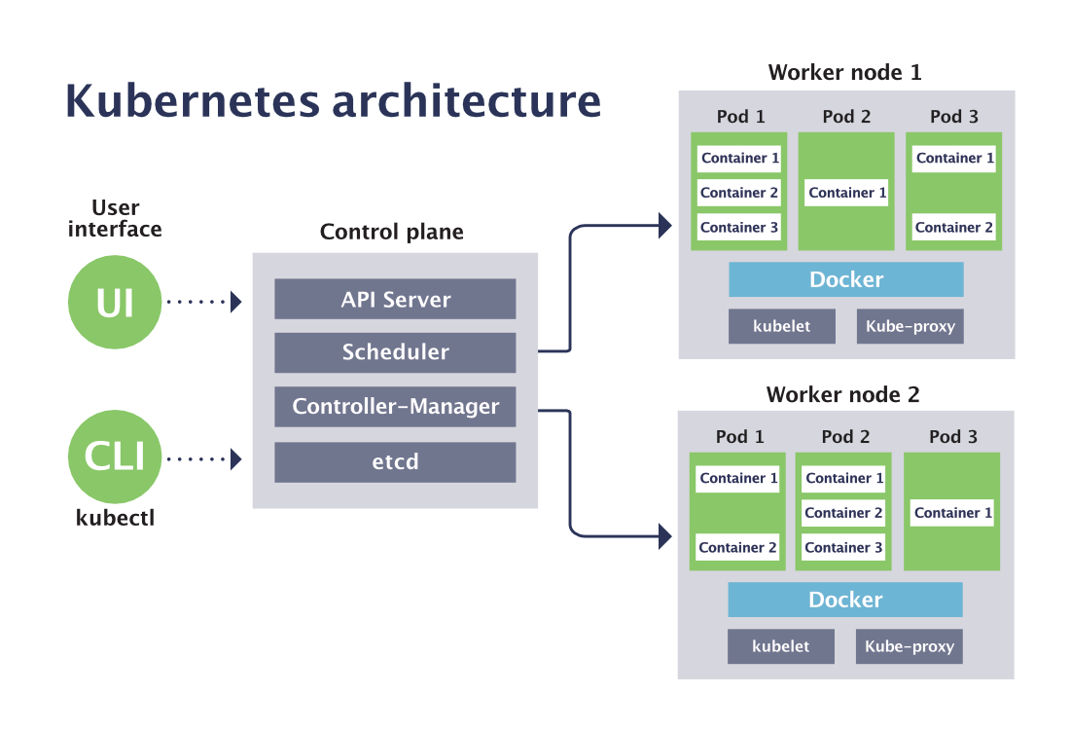
Kubernetes Architecture

Slide 5
Kubernetes Terminologies
A cluster is a set of nodes that run containerized applications and are managed by the master node.
A node is a machine in the cluster that runs pods. Nodes can be either master or worker nodes.
A pod is the smallest unit of deployment in Kubernetes. A pod consists of one or more containers that share the same network and storage.
A service is an abstraction that defines a logical set of pods and a policy to access them. Services provide load balancing, service discovery, and external access to pods.
A deployment is an object that defines the desired state of a pod or a set of pods. Deployments manage the creation, scaling, and updating of pods.
A replicaSet is an object that ensures that a specified number of pod replicas are running at any given time. ReplicaSets are usually created and managed by deployments.
An ingress is an object that defines rules for external access to services in the cluster. Ingresses use an ingress controller to route traffic according to the rules.

Slide 6
Kubernetes Terminologies
A configMap is an object that stores configuration data as key-value pairs. ConfigMaps can be mounted as volumes or environment variables in pods.
A secret is an object that stores sensitive data such as passwords, tokens, or keys. Secrets can be mounted as volumes or environment variables in pods.
A volume is an object that provides persistent storage for pods. Volumes can be either local or remote, and support various types of storage backends.
A namespace is an object that creates a logical isolation for resources in the cluster. Namespaces can be used to group resources by project, team, or environment.

Slide 7
Installation
Minikube
Used to run k8s clusters in your local machine/computer
Minikube runs a single-node Kubernetes cluster on your machine so that you can try out Kubernetes for your daily development work.
Installation link :
https://minikube.sigs.k8s.io/docs/start/
Once installed, we can start minikube by the following command
minikube start
We can use Docker driver. Make sure docker is up and running.
Kubectl
A Command-line tool that lets users interact with Kubernetes clusters to manage and deploy applications:
Kubectl allows users to create, update, and delete resources like pods, services, and deployments.
It also lets users manage cluster resources, monitor resources, and view logs.
Kubectl communicates with the Kubernetes API server by authenticating with the cluster's Master Node and making API calls.
Installation link :
https://kubernetes.io/docs/tasks/tools/install-kubectl-windows/

Slide 8
Start Minikube
Once installed, we can start minikube by the following command
minikube start –driver=docker
We can use Docker driver. Make sure docker is up and running.
After Minikube has started, we can check the status of minikube by the command
minikube status
We should see the following output.
minikube
type: Control Plane
host: Running
kubelet: Running
apiserver: Running
kubeconfig: Configured

Slide 9
Verify Minikube
Once we start minikube, it will create a single node cluster.
To verify if the cluster is created type the command,
kubectl cluster-info
To get the single node info type the command
kubectl get node

Slide 10
Kubernetes to read local docker registry
Let us deploy the authentication-service docker container in a Kubernetes node.
So how can we tell Kubernetes to read our local docker registry?
Specify the following command
minikube docker-env
Copy the last line excluding REM and run it.
Now Kubernetes can read the local docker repository.

Slide 11
Create service.yml
apiVersion: v1
kind: Service
metadata:
name: nginx-service
labels:
env: sandbox
spec:
type: LoadBalancer
ports:
- port: 80
selector:
env: sandbox

Slide 12
Create deployment.yml
apiVersion: apps/v1
kind: Deployment
metadata:
name: nginx-deployment
labels:
env: sandbox
spec:
replicas: 3
selector:
matchLabels:
env: sandbox
template:
metadata:
labels:
env: sandbox
spec:
containers:
- name: nginx
image: nginx
ports:
- containerPort: 80

Slide 13
Execution steps
Create Kubernetes service
kubectl create -f service.yml
Create Kubernetes deployment
kubectl create -f deployment.yaml
Wait until the 3 deployment pods have created. Once they state ‘Running’, they have successfully created.
kubectl get pods
Assign the service URL with Minikube
minikube service nginx-service
Default web browser should open up and show nginx index page

Slide 14
Minikube Dashboard
Type the command,
Minikube dashboard
See the pod, deployments etc…
Try deleting one pod and you will see that Kubernetes will create another pod as the replica is mentioned as 3.
This is called self healing in Kubernetes.
Once done we can clean all resources
minikube delete --all

Slide 15
END

